Slide 1
Puzzle
“Who in the world am I? Ah, that’s the great puzzle.” ~ Lewis Carroll

Slide 2

Mission…
“Using the recognition gained build a testable map of a high level architecture from evidence and experimentation”

Slide 3

Objectives…
Learning Objectives:
Interpret multiple oracles of information to determine a previously unarticulated architecture
Diagram the architecture using common architectural notations and visual dictionary from the first exercise
Assess architectural evidence to determine reliability of the available oracles

Slide 4

Oracle Problem!

Slide 5

Exercise…
ID Resolver!
Who are you?
Existing application!
History!
Clients!
Dev team!
Support Team!

Slide 6
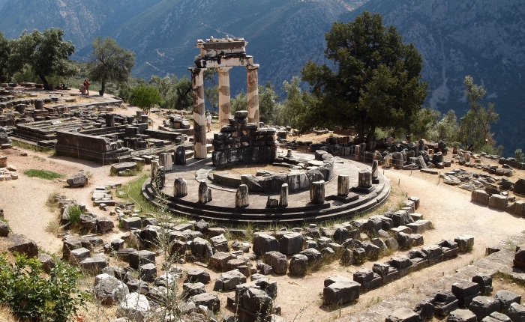
Oracles!
Symbols!
Anecdotes!
Bugs!
Original Diagrams!
Performance Stats!

Slide 7
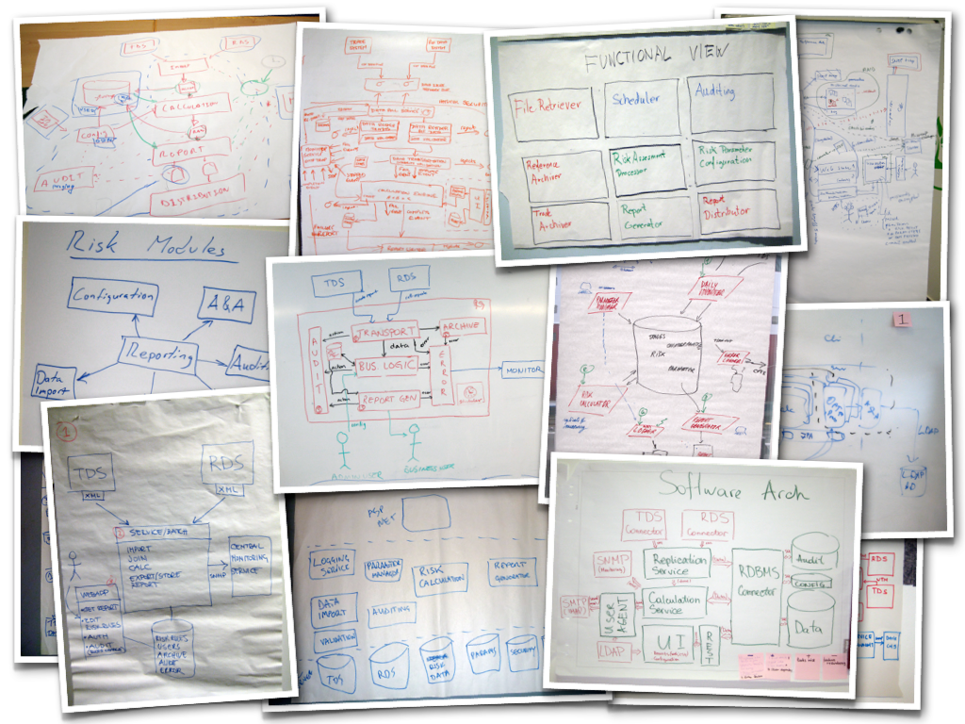
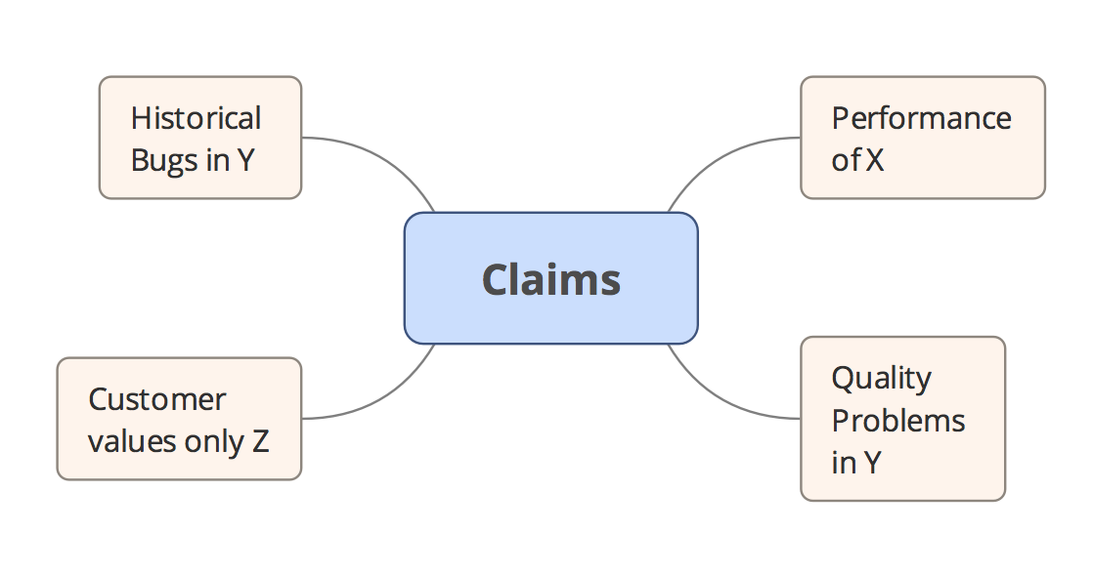
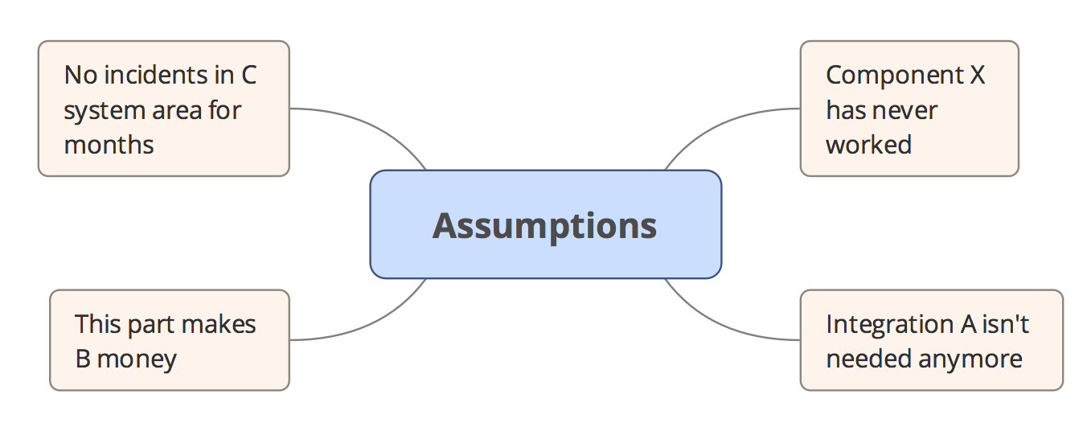
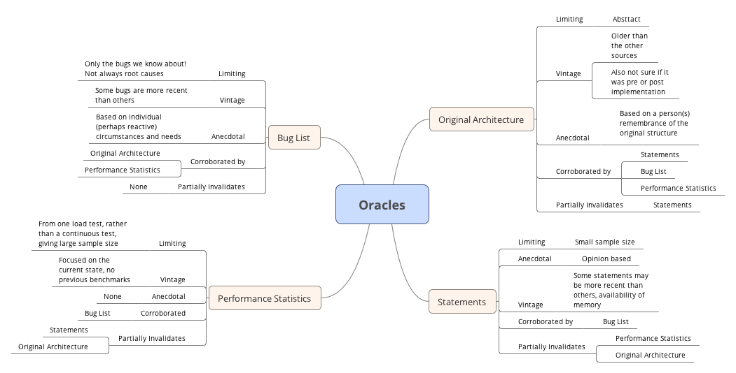
Par example…

Slide 8

Summarise…
To you…
To Me…

